Slide 1
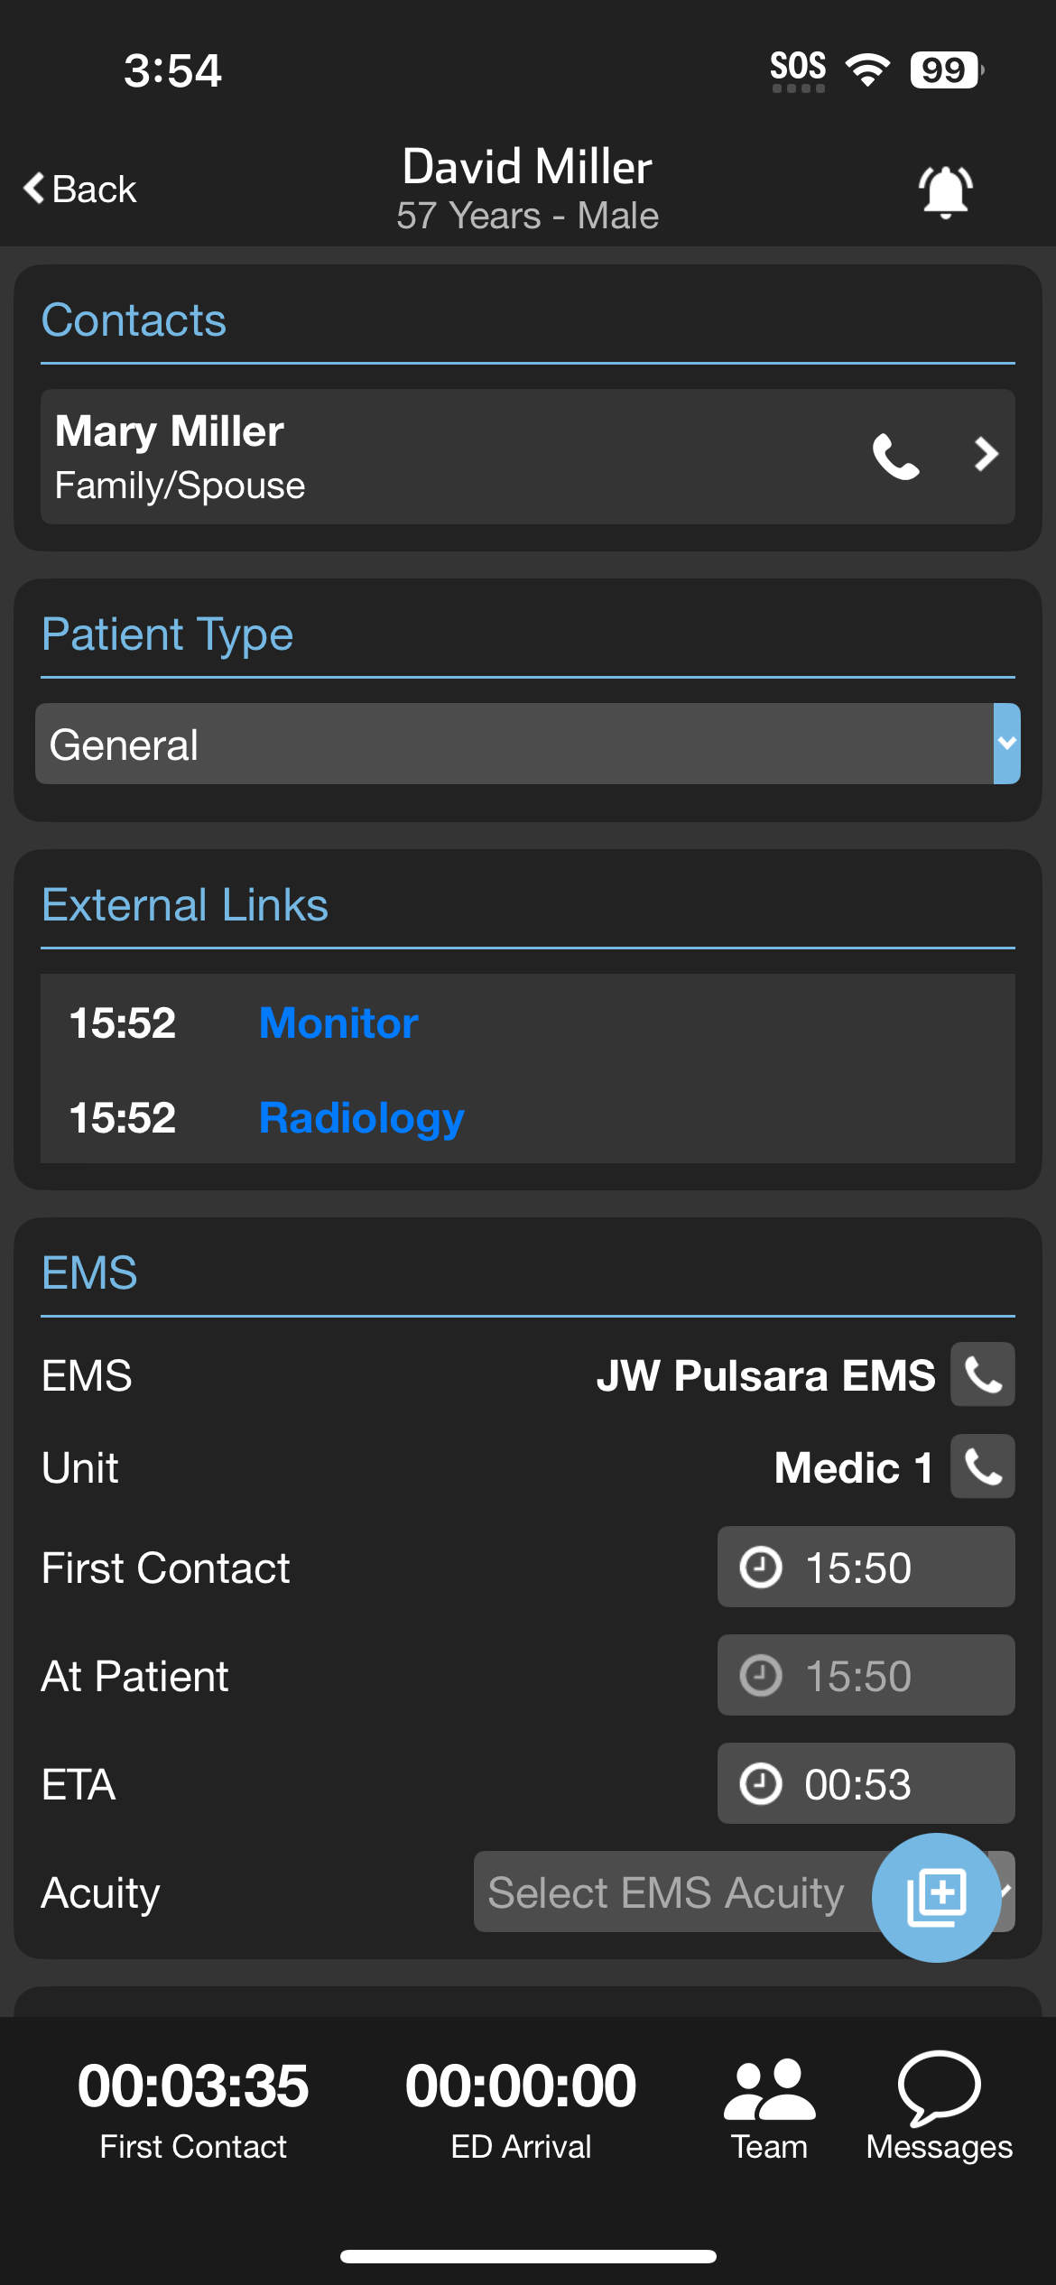
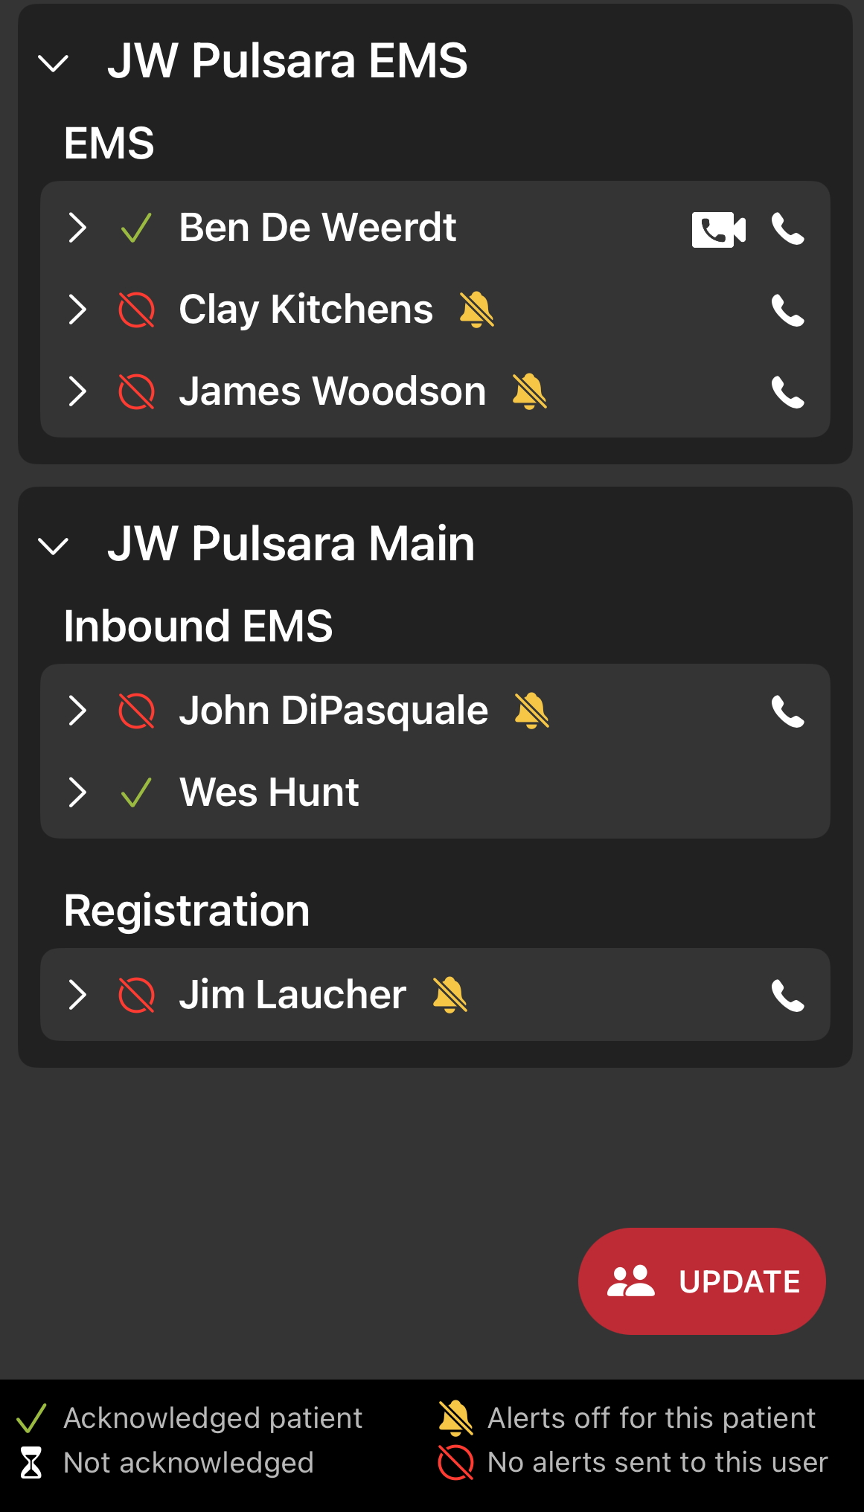
Notes:
Let’s walk through how to use both traditional phone calls, and Pulsara Calls for seamless, two-way communication.
To make a traditional call, just tap the phone button. If you’re on a phone-enabled device, it’ll open your phone app and enter the number for you to call. If not, no worries—the number will still display so you can call it manually.
Now, let’s talk about Pulsara Calls. These only need an internet connection—so no SIM card, no phone number, no problem. Just tap the video icon to start a call. The recipient’s device will ring like a regular phone call, and you can choose whether you want video or audio only.
We’ll cover how to set your default call preferences in another lesson, but you can always adjust them during the call too. Need to keep a record? Call recording is available when needed.
In the EMS card, you can call the agency—usually a recorded line—or, if it’s enabled, the specific unit’s phone. Other departments, like the ED or Cath Lab, also have their own cards with contact numbers for quick access.
To reach someone on the care team, tap the Team icon to open the Team Screen. Pulsara connects care teams across different organizations, so everyone’s listed by Organization and Team. From there, you can choose to make either a traditional or Pulsara call—whichever works best.
Need to reach someone outside the care team? Use the Contacts card—you’ll have the same call options there too.
Whether you’re calling within your organization or across multiple facilities, Pulsara makes it simple to stay connected and keep communication flowing.

Slide 2
Notes:
To make a traditional call, just tap the phone button. If you’re on a phone-enabled device, it’ll open your phone app and enter the number for you to call. If not, no worries—the number will still display so you can call it manually.

Slide 3
Notes:
Pulsara calls only need an internet connection—so no SIM card, no phone number, no problem. Just tap the video icon to start a call. The recipient’s device will ring like a regular phone call, and you can choose whether you want video or audio only.

Slide 4
Notes:
In the EMS card, you can call the agency—often a recorded line—or, if enabled, the unit phone directly.

Slide 5
Notes:
Other departments like the ED or Cath Lab have their own cards with contact numbers.

Slide 6
Notes:
To reach someone on the care team, tap the Team icon to open the team screen.

Slide 7
Notes:
Pulsara connects teams across organizations, so everyone is listed by Organization and Team. From here, you can make a traditional or Pulsara call, depending on what’s available.

Slide 8
Notes:
You can also contact non-care team members through the Contacts card using either call method.

