Slide 1
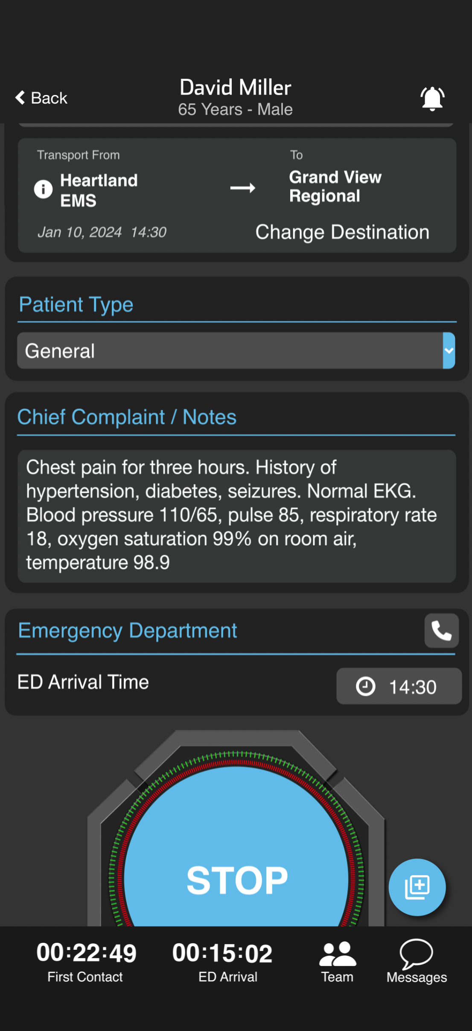
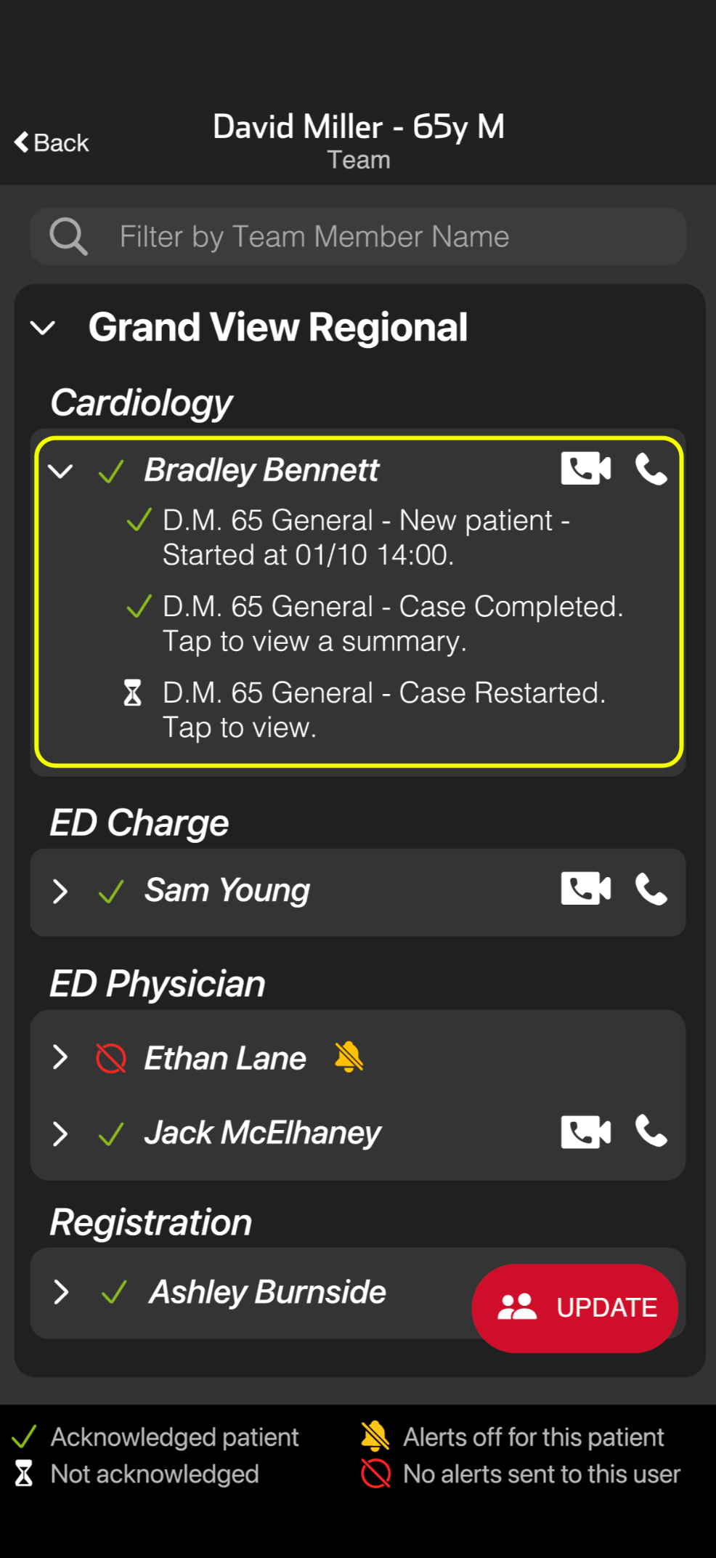
Notes:
Let’s review how to stop and restart a channel.
To stop a patient channel, tap STOP at the bottom of the screen once the patient has arrived and the channel is no longer needed. Organizations that have downstream care teams enabled for time sensitive emergencies may have them handle this step.
When a channel is stopped, all team members receive a distinct push notification. For critical patients or time-sensitive emergencies, some hospitals choose to send additional updates to provide closed loop feedback to their referral partners.
Stopped channels remain visible on the Patient List for a set time defined by your organization. You can still add data, but no push notifications are sent during this status.
To restart a stopped channel, tap to open it from the patient list view, scroll down, and select Restart Case. A push notification is sent to the team. Tap the Team icon to see who has viewed the reopened case—green checkmarks show acknowledgment. If a critical team member hasn’t seen it, tap the video or phone icon to call them directly.

Slide 2
Notes:
To stop a patient channel, tap STOP at the bottom of the screen once the patient has arrived and the channel is no longer needed. Organizations that have downstream care teams enabled for time sensitive emergencies may have them handle this step. When a channel is stopped, all team members receive a distinct push notification. For critical patients or time-sensitive emergencies, some hospitals choose to send additional updates to provide closed loop feedback to their referral partners.

Slide 3
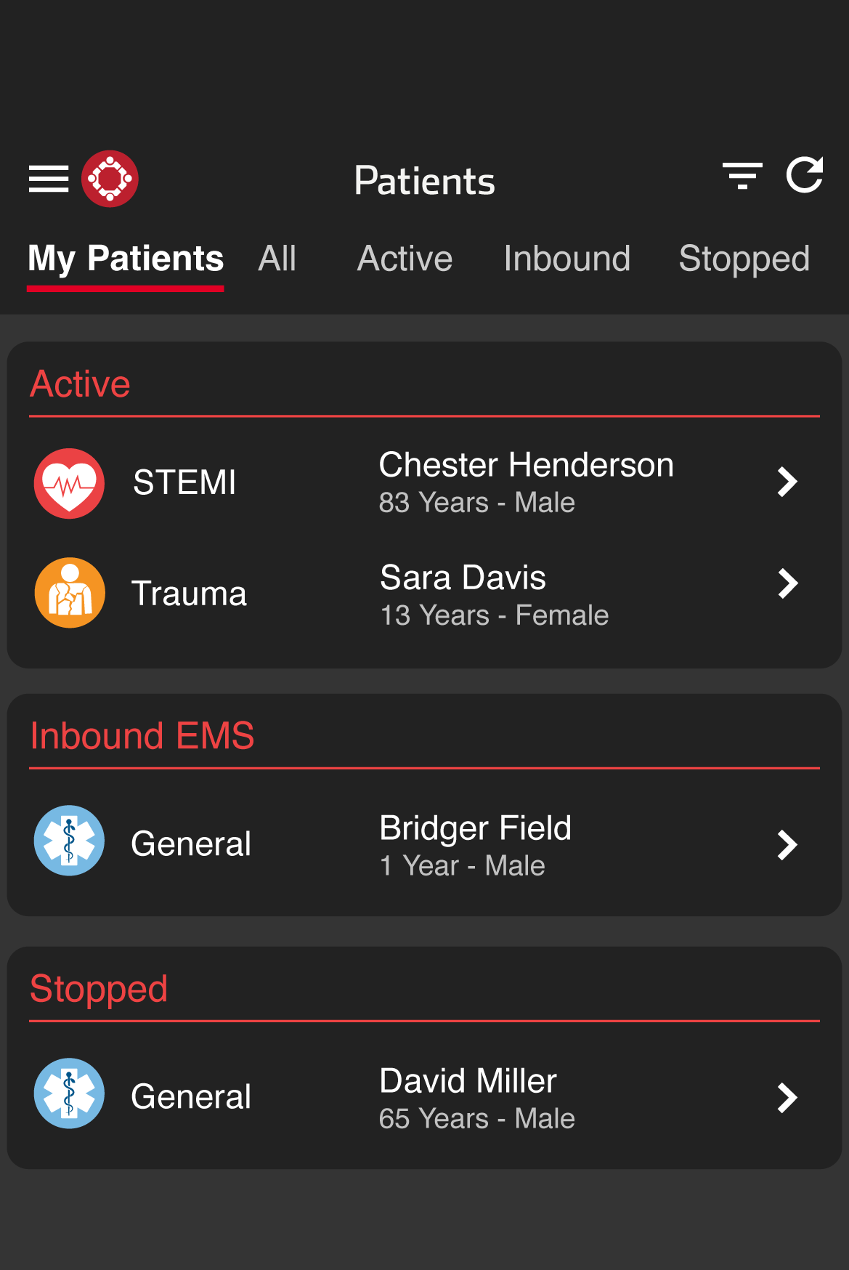
Notes:
Stopped channels remain visible on the Patient List for a set time defined by your organization. You can still add data, but no push notifications are sent during this status.
To restart a stopped channel, tap to open it from the patient list view, scroll down, and select Restart Case. A push notification is sent to the team. Tap the Team icon to see who has viewed the reopened case—green checkmarks show acknowledgment. If a critical team member hasn’t seen it, tap the video or phone icon to call them directly.

Slide 4
Notes:
Tap the Team icon to see who has viewed the reopened case—green checkmarks show acknowledgment. If a critical team member hasn’t seen it, tap the video or phone icon to call them directly.

